Slide 1
Predicting Stock Market Trends through
Monte Carlo Simulation
Using Python and GBM Model
Anwar Kamal Sadat
Arian Wazed
Moinul Hossain Bhuiyan Nazia Ahmed Nijhum

Slide 2
Literature Review
The Monte Carlo method is used for assessing price options, but its application in forecasting stock returns is less common. This paper aims to contribute to this area by integrating information and approaches from relevant disciplines, bringing a new viewpoint on predicting stock returns through the use of the Monte Carlo methodology. The COVID-19 pandemic caused severe instability and disruption in the global stock market in 2020, with government intervention and incentive programs helping stabilize markets. The technology and healthcare industries remained resilient, with markets beginning to rebound in the second half of 2020. However, continued uncertainties and geopolitical tensions exacerbated financial market concern. The 2020 COVID chaos was the quickest and biggest crash in stock market history, with 11 bear markets since 1956.

Slide 3
Literature Review Contd.
Bear markets often follow bull markets, with strong and resilient companies becoming more powerful. However, the recovery period can be lengthy, as seen in the 2008 crisis, which took 49 months to recover to pre-crash levels. To manage bear markets, it is crucial to consider the recovery time.Monte Carlo Simulations are an excellent tool for forecasting stock market movements, especially when prior share prices have exhibited random behavior with little changes. These simulations are performed after identifying the variables of the GBM model, including Drift and Shock, and the results are visually examined.

Slide 4
Implementation Results and Outcomes
To avoid biased findings, a Monte Carlo Analysis was conducted using Python and numerous simulations. The GBM model's parameters, such as Drift and Shock values, were based on market statistics from stooq.com. The data outputs from the GBM model were combined with Monte Carlo Analysis to simulate the future movement of market indexes based on past volatility. The Monte Carlo approach, which relies on probability, is widely used and suggested for including uncertainties.One difficulty investors face is evaluating the likelihood of stock price movement. One solution is to replicate price fluctuation using the Monte Carlo approach. However, these assumptions are erroneous, so analysts must use caution when interpreting results.To begin, determine the data to work with, create a model using GBM (Geometric Brownian Motion) and define essential parameters. Run 1000 simulations to model Samsung's stock price over the coming year, using data from the previous 5 years to determine model parameters (anticipated annual return and expected yearly volatility). The period in which assumptions are built is crucial, and analysts should select a timeframe that closely resembles the forecast period or manually provide the projected annual return and volatility.

Slide 5
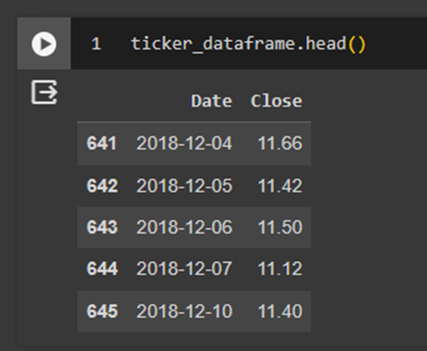
Data Cleaning
That’s what our refined Data is going to look like

Slide 6
Implementation contd.
The focus is on creating a simulation model using the Monte Carlo Method and the Geometric Brownian Motion (GBM) method. The Monte Carlo function is simple, iterating over a specified function and recording each iteration. The GBM method is more complex, employing equations from a 2016 research article by Reddy and colleagues.

Slide 7
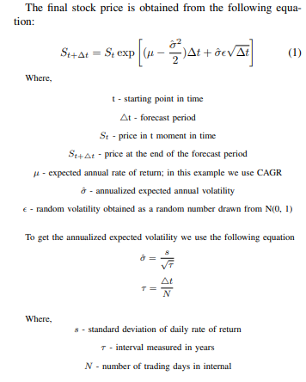
Implementation contd.
After we implemented the following equations into the python code, there is one thing left to do, and that is to run the simulation and observe the results. After running 1000 simulations, we get the results.

Slide 8
Discussion
Monte Carlo Simulation is a statistical modeling tool used for stock price prediction. It simulates multiple possible future trajectories of a stock's value by adding random factors and entering historical data. The simulation provides a range of possibilities, emphasizing the inherent unpredictability in financial markets. The results show a full collection of probable stock price possibilities, revealing significant risk factors and unusual scenarios for investors to consider.
The discussion phase of the Monte Carlo Simulation on stock prices involves an extensive review of the results, assessing the model's robustness, identifying differences between simulated and actual market behavior, and acknowledging its shortcomings. This phase is critical for improving the simulation's predicted accuracy and increasing its dependability. Comparisons with different prediction approaches can confirm the usefulness of the Monte Carlo simulation approach in specific scenarios.
In conclusion, Monte Carlo Simulation provides a thorough picture of probable future scenarios, assisting investors in making educated decisions on the constantly changing and uncertain financial market landscape.

Slide 9
Conclusion
To achieve impartial results in stock market forecasts, we used Monte Carlo Analysis, which was run using Python with multiple simulations. The parameters of the Geometric Brow7 nian Motion (GBM) model were carefully calculated using market statistics, allowing for a robust Monte Carlo simulation. While we acknowledged the generally accepted usefulness of the Monte Carlo technique in dealing with uncertainty, we emphasized caution due to underlying assumptions. The study illustrated the Monte Carlo Simulation GBM model’s actual applicability, demonstrating its great accuracy in fulfilling objectives. This method has the potential to help traders make informed judgments based on detailed insights into previous and predicted market movements. We ran a simulation and plotted the results. We modeled Samsung’s stock price during the last year using 1000 simulations. We used data from the preceding five years to calculate model parameters such as predicted annual return and expected yearly volatility. The most crucial part of the model was the time span in which we established our assumptions. This highlights the Monte Carlo method’s potential as a helpful decisionmaking tool, leading to a need for more research to show its application in larger corporate situations. Overall, our findings contribute to the advancement of advanced analytical tools and the refinement of financial modeling approaches in the dynamic finance industry.

Slide 10
Thank You

